Slide 1
A Comprehensive Web-Based Course & Exam Management System
Presented To:
Mir Faiyaz Hossain
Lecturer Department of Computer Science & Engineering,
Daffodil International University
Prsented By:
Nurjahan Akther Mim 221-15-4782
Abu Zahed 221-15-4716
Md Amir Hamja 221-15-4784
Arnub Datta 221-15-4726

Slide 2
TABLE OF CONTENTS
Introduction
Problem Statement
Project Description & Scope
System Architecture & Design
Key Challenges
Future Work
Conclusion

Slide 3
INTRODUCTION
The Course & Exam Management System is a web application that helps teachers and students manage learning online. Teachers can create courses, share materials, give assignments, and conduct online exams. Students can join courses, access lessons, submit assignments, take exams, and see their grades.
The system is secure, easy to use, and works on all devices. It keeps track of everything in a database, shows personalized dashboards, and sends notifications for new assignments or exams. The main goal is to make online learning simple, organized, and fair for everyone.

Slide 4
Problem Statement
Manual Exam Processes
Human errors in grading and result compilation Difficulty in maintaining consistent examination
Administrative Burden
Complex scheduling and coordination of exam sessions
Manual student enrollment and course management
Limited Accessibility
Lack of real-time exam monitoring and feedback
No support for students with special needs
Resource Wastage
Excessive paper consumption and printing costs
Storage challenges for physical exam records

Slide 5
Project Description
User Management: Secure registration and login with role-based access for Instructors, and Students.
Course Management: Instructors can create courses, post announcements, upload learning materials, and manage student enrollment.
Assignment Management: Instructors can create assignments; students can submit work online, and instructors can grade and give feedback.
Exam Management: Timed exams for certain student groups; multiple-choice questions are graded automatically, and other answers are graded by the teacher.
Grades & Feedback: Centralized gradebook for instructors; students can view their grades and instructor feedback.
Responsive & Validated Design: The application works on desktops, tablets, and mobiles, with proper form validations.
API Integration: Rich text editor for content, email notifications for deadlines, and file storage for assignments in Google drive.

Slide 6
Scope
Manage courses, assignments, and exams in a single web platform.
Provide secure user authentication with roles: Admin, Instructor, and Student.
Allow instructors to create courses, upload materials, and post announcements.
Enable students to enroll in courses, submit assignments, and take exams online.
Conduct timed exams with auto-grading for MCQs and manual grading for short answers.
Maintain a central gradebook for tracking grades and feedback.
Provide responsive design for desktop, tablet, and mobile devices.
Include optional features like rich text editing, email notifications, and file storage.
Reduce administrative workload and streamline teaching, learning, and assessment.
Ensure data integrity, security, and proper form validation throughout the system.

Slide 7





Tools Used In Project

Slide 8
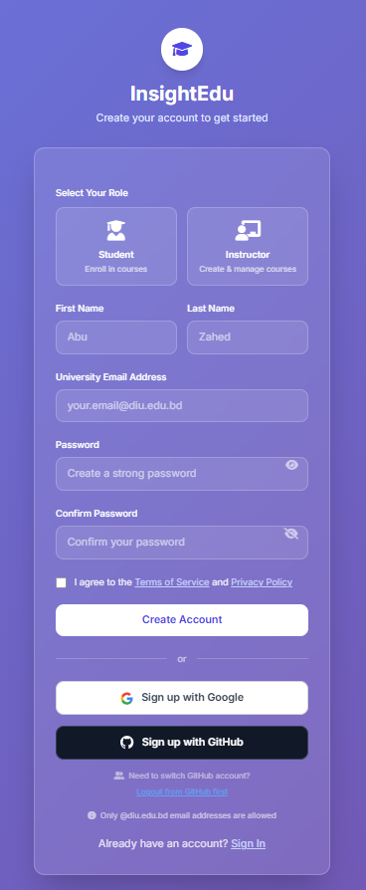
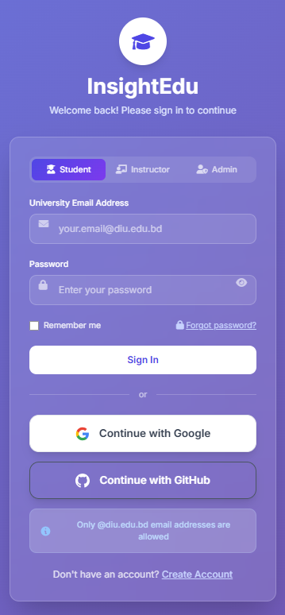
Feature

Slide 9
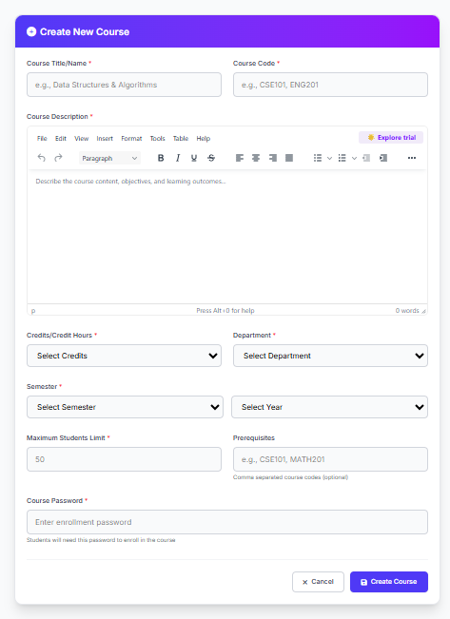
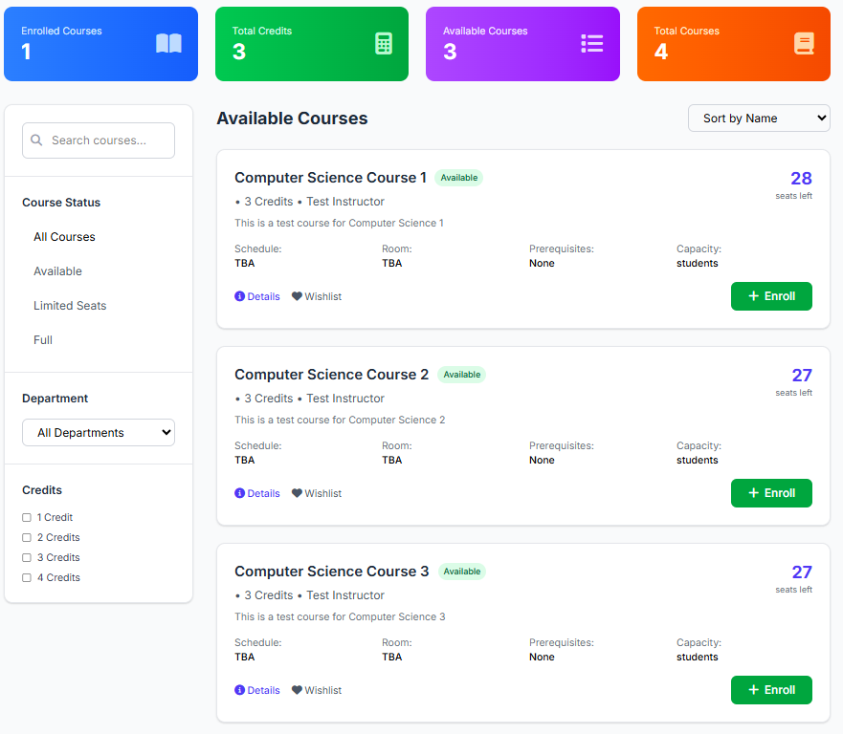
Feature

Slide 10
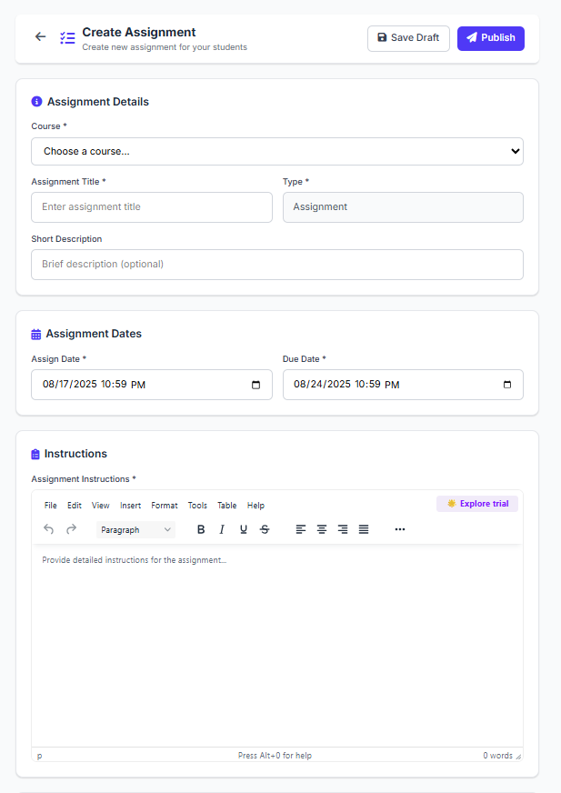
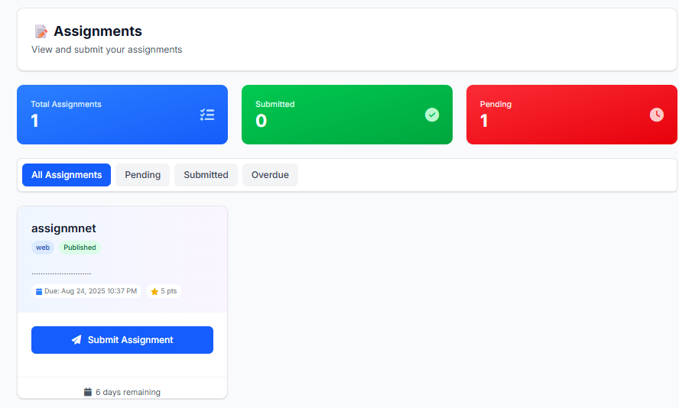
Feature

Slide 11
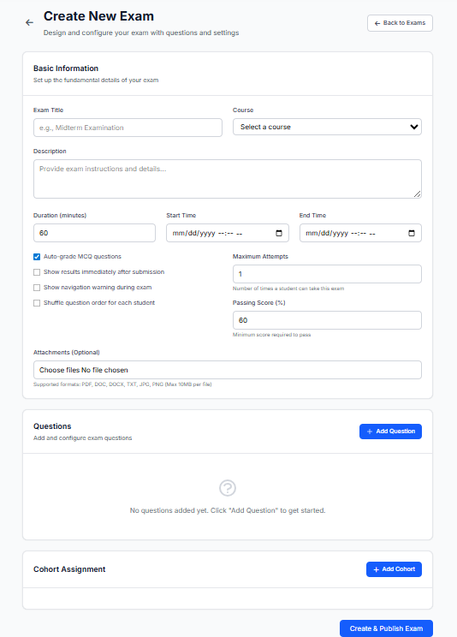
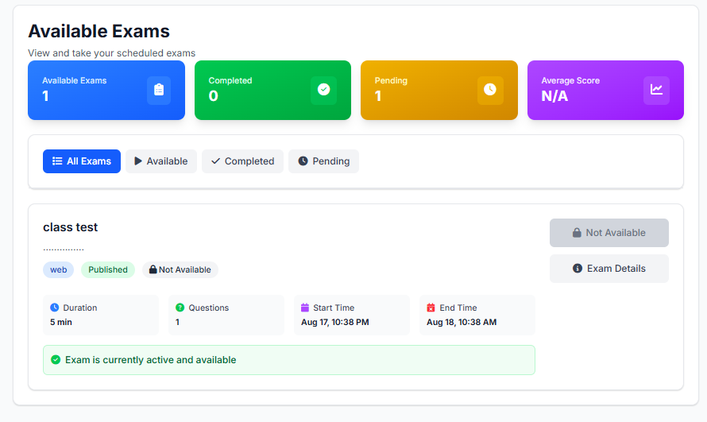
Feature

Slide 12
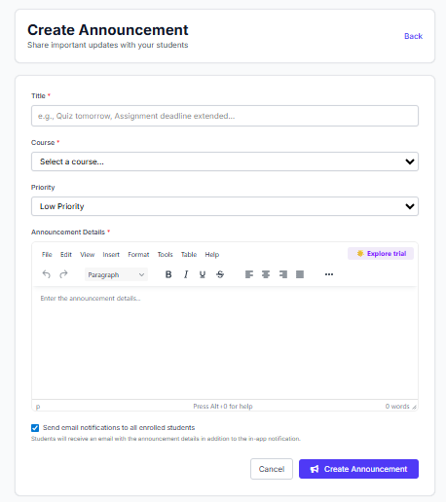
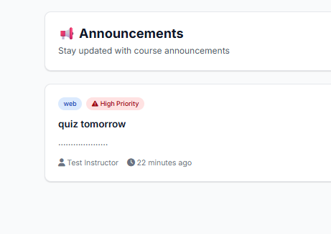
Feature

Slide 13
Key Challenges
Technical Challenges
Real-time auto-save using AJAX to prevent data loss
Accurate time management with server-side validation
Optimized database for concurrent user handling
Ensured cross-browser and device compatibility
Security Challenges
Multi-layered security for exam integrity
Data encryption and strict access controls
Robust session management to prevent hijacking
User Experience Challenges
Intuitive, user-friendly interface design
Optimized performance for speed and stability
Accessibility for users with varying technical skills

Slide 14
Future Work
AI & Analytics: Predictive insights, personalized learning.
Security: Biometrics, AI proctoring, blockchain certificates.
Mobile Apps: Offline exams, notifications, mobile-friendly UI.
Advanced Assessments: Multimedia, coding, virtual labs.
Emerging Tech: VR/AR exams, IoT classrooms, voice navigation

Slide 15
CONCLUSION
The Course & Exam Management System provides an efficient and secure platform for managing courses, assignments, and exams. It simplifies the teaching and learning process by allowing instructors to create courses, post materials, conduct timed exams, and grade assignments easily. Students benefit from easy enrollment, online assignment submission, and instant access to grades and feedback. The system reduces administrative workload, ensures exam integrity, and offers a responsive and user-friendly interface. Optional features like rich text editing, notifications, and file storage further enhance the learning experience. Overall, the project achieves its goal of streamlining academic management for both instructors and students.

Slide 16
THANK YOU!😃

